Slide 1
Predicting Fraudulent Job Postings
contributors: Khashayar Behyar (Group 9)
Janzen Liu (Group 9)
Ikyu Park (Group 9)
Anthony Ransom (Group 9) Date: August 2022
Notes:
Thank you for attending our presentation for our project on predicting Fraudulent Job Postings
<to give some background on why we started this project>

Slide 2
Background & Purpose
This Project was created knowing that:
Fraudsters and scammers use of phishing techniques within job posting to gain access to private information
Unsuspecting job seekers provide personal information believes job posts on popular job boards are safe without knowing the dangers
The purpose of this project is to:
Create a machine learning model to integrate with job board systems
Accurately determine if a newly created job posting is fraudulent
Prevent identity theft
Notes:
Background
in the modern age the ability for fraudsters and scammers to access information through phishing techniques is unprecedented, unsuspecting victims often succumb to methods such as phone calls, emails or even fake job postings that these bad actors use to gain access to private information
Purpose
In an effort to prevent identity theft, we aim to create a machine learning model that when integrated within job board systems can accurately predict fraudulent job postings based on several parameters in order to protect unsuspecting job seekers from identity fraud
<with our purpose defined we looked to create a process that we could follow to prepare our machine learning model>

Slide 3
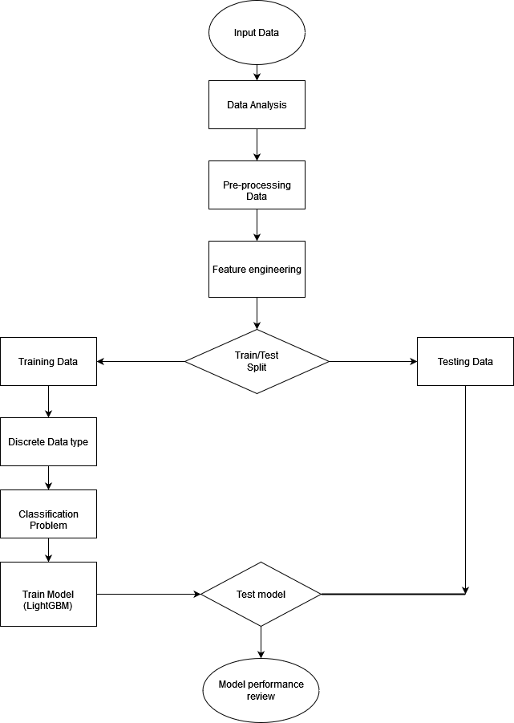
Process
Data Analysis/Exploration
Data preprocessing
Feature engineering
Split data into training and testing datasets
Trained the machine learning model
Tested machine learning model
Review the model performance and tuned the model accordingly
Use model to score new data
Notes:
We followed a simple process in order to create a working model
Using our sample dataset we went through
Data analysis and exploration to determine which data is relevant,
Data preprocessing to clean the data,
Feature engineering to encode the data so it is ready to go into the machine learning model,
Split the dataset into training and testing datasets,
Trained and tested the machine learning model,
Review the model performance and tuned the model accordingly,
Prepare the model to score new data
<knowing the process we would take to create the model we started with analysis and exploration of our dataset>

Slide 4
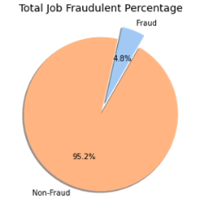
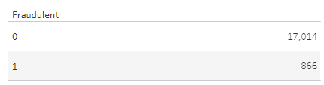
Data Analysis - Data Overview
Dataset obtained from Kaggle
Database Integration with Postgres & AWS RDS
17838 data points with 17 features and 1 target
Identified target Feature in dataset marked as “Fraudulent”
Target Feature data is skewed within dataset
Notes:
The dataset that was used to train the model was obtained from Kaggle and uploaded to a postgres SQL database running on an AWS RDS instance
The sample dataset contains over 17,000 data points with 17 features that could be used to train the model and 1 target feature
From the offset it was identified the sample dataset was skewed as shown by this graph where only about 5% of the data is identified as fraudulent which would pose a challenge when training the machine learning model
<in order to overcome this challenge we looked further into the data>

Slide 5
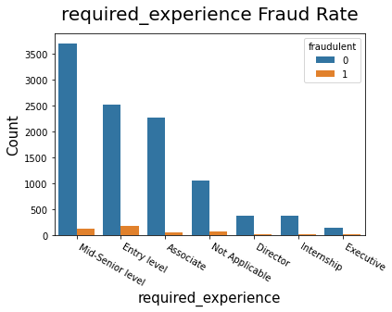
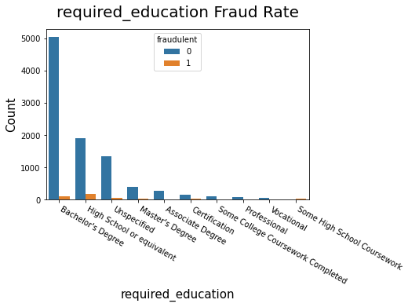
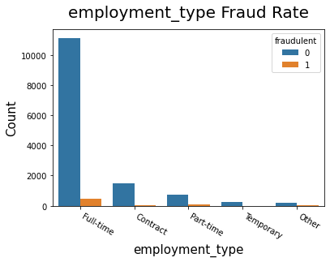
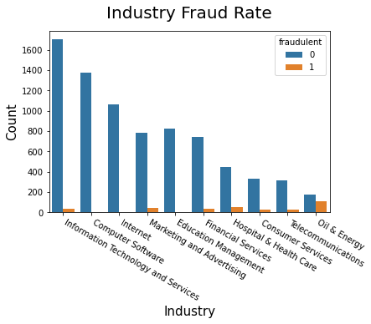
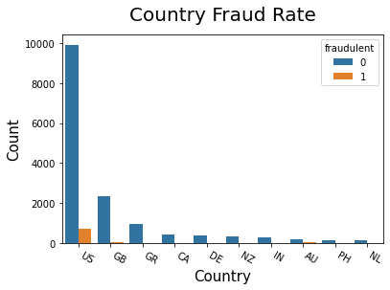
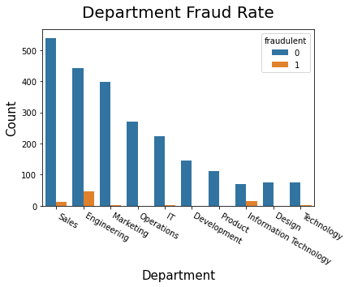
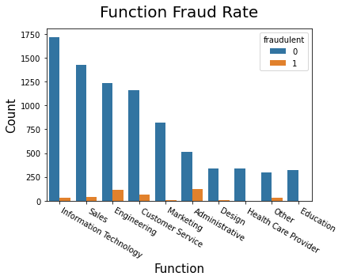
Data Analysis/Exploration - Feature to Target Relationship
Notes:
We wanted to see the relationship of the features in the dataset to the target, you can see from these graphs we can already visually identify some interesting relationships shown by these red circles where the number of identified fraudulent data points is disproportionate to the rest
for example the oil & energy industry shows a high amount of fraudulent data points compared to the number of non-fraudulent data points and the other industries represented in the dataset
<after exploring the dataset and with this knowledge in mind we moved to preprocess the data based on the our findings>

Slide 6
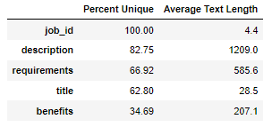
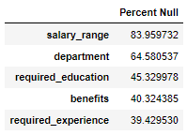
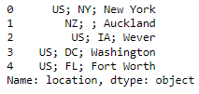
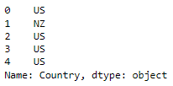
Data Preprocessing
Country
Job ID is an identification column and has no relation to the target Feature and was dropped
Title contained majority unique values with a small word count and was dropped
Salary_range has majority null values and was dropped - cutoff was 80% null values
States and cities removed from dataset keeping only Country due to numerous incorrect spelling and entries with multiple cities and missing entries
Null values changed to “Not Specified” for remaining features due to the already limited number of data points
Notes:
We removed some features that we did not find relevant such as job_ID along with some features that had too many null values or had too many unique values
We then removed cities and states and kept only the country due to the number of missing entries for cities and states and the various entries that had multiple cities and states listed
Null values were changed to not specified as we did not want to remove any data points due to the already limited number of fraudulent data points in the dataset
<after we preprocessed the data we moved to prepare the remaining features so they could be used within the machine learning model>

Slide 7

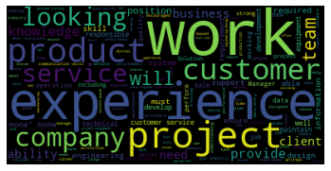
Feature Engineering -
Natural Language Processing
Non-Fraudulent Top Words
Fraudulent Top Words
Natural Language Processing (NLP) used to process features with large amounts of text in each job posting
Removal of punctuation and stopwords (“the”, “a”, “an”, “so”, “what”)
NLP was used to identify the words that are most relevant to determine if a job posting is fraudulent
Notes:
We first used Natural language processing in order to remove unnecessary punctuation and stopwords such as the, a, an, so and what
this helped to remove common words that are used often in sentence structure so they would not skew the importance of other keywords
using NLP we then identified the words that are most relevant in identifying if a job posting is fraudulent or not
for example the words experience and product as shown by this word cloud are commonly used in job postings that are identified as fraudulent while words such as project and team are most commonly used in job postings that are identified as non-fraudulent
<Once we completed the NLP process we then looked at encoding the rest of the data>

Slide 8
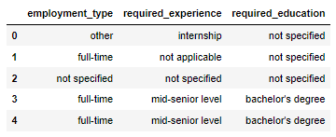
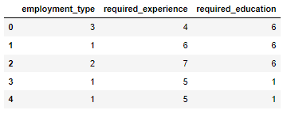
Feature Engineering - Ordinal Data Types
Ordinal Data types is data that has a natural/set order
  Example: Internship -> entry level -> Associate -> Director -> Executive
Label Encoder was used to convert these features to numeric form for the machine learning model
=>
Notes:
we identified two types data that needed to be encoded
the first one is Ordinal data
Ordinal data is data that has a natural or set order to them,
for example when someone starts working they may start as an intern and then move into an entry level position then become an associate making their way up to executive level which shows a clear order of progression
Label encoding was used in order to encode these types of data into numerical format that could be used with the machine learning model as shown by these sample images
<>
Target Encoding not used as overtime new values will be introduced and can lead to overfitting

Slide 9
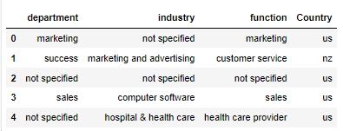
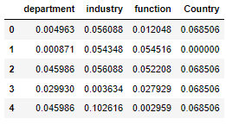
Feature Engineering - Nominal Data Types
Nominal data is data grouped into categories with no meaningful order between the categories
  Example: Computer Software industry vs Hospital & Health Care industry
Target Encoding was used in order to convert these features to numerical form based on the mean of the target feature (Fraudulent) to the count for each category
=>
Notes:
the second is nominal data
Nominal data is data that can be grouped together but has no meaningful order to them
for example the Computer software industry and Hospital & health industry can be grouped in their own categories but they have no meaningful relationship to each other
Nominal data is encoded to numerical format by looking at the total count for each category and determining the average count of that category compared to the number of target data points for that category as shown by these sample images
<once our feature engineering was completed we then started to prepare our machine learning model>

Slide 10
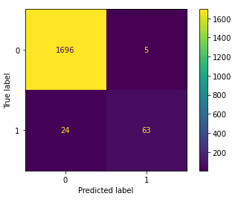
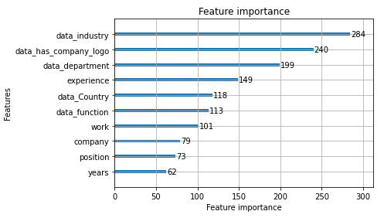
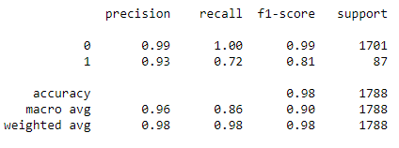
Machine Learning Model
Goal is to achieve high accuracy from the machine learning model
Classification type machine learning model
LightGBM machine learning model was chosen due to it higher performance to accuracy output
Accuracy value of 98% meaning that 2 of every 100 job postings analysed are labeled incorrectly and 98 is correctly labeled
Recall value of 72% means that 28 of every 100 fraudulent job postings analysed in reality are missed by the model and 72 are correctly identified as fraudulent
Notes:
The goal of the machine learning model was to achieve high accuracy using a classification type of model
We determined the LightGBM model provided the best performance to accuracy output for the purpose of this project
Through training, tuning and testing of the model an accuracy of 98% was achieved meaning that 2 of every 100 job postings were labeled incorrectly while 98 were labeled correctly
and a recall value of 72% was achieved meaning that 28 out of 100 fraudulent job postings were missed by the model while 72 we correctly identified as fraudulent
looking in depth at the model we were able to see that the industry, company logo and department features were the top 3 features the model used to determine if a job posting is fraudulent
<with a working model we created a live interactive dashboard that could be used to monitor the statistics of fraudulent job postings>

Slide 11
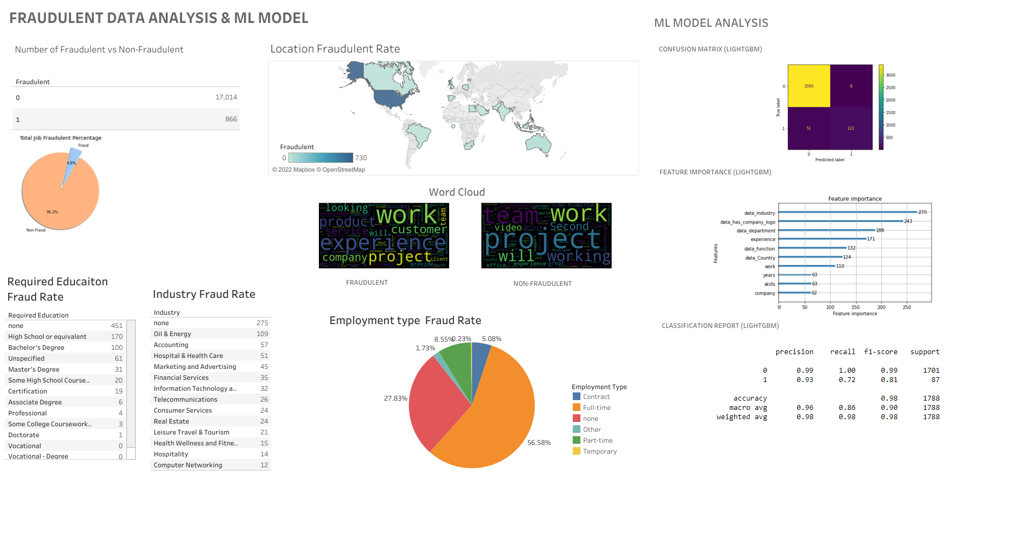
Live Tableau Dashboard
Notes:
With this dashboard administrators would be able to see clearly how the model is performing as the model learns from new data provided over time while also showing statistics for the various features within the data that the model is learning from such as total fraud vs non-fraud postings, the locations with the highest job fraud and many other statistics
<in conclusion>

Slide 12
Conclusion and Improvements
Fraud through job postings is prevalent which our machine learning model achieved high accuracy in predicting the job postings bad actors are using to gain access to private information.
A larger dataset can be used to improve the machine learning model and once the model has been implemented in a live system will improve over time as the model learns
This model could be implemented to analyse each new job posting that is created to determine if a job posting would be used for fraudulent purposes and prevent the job postings from going onto the live public job board
Notes:
Fraud is prevalent in all areas of society and even with this small dataset used in this project we were able to create a machine learning model that can accurately determine if a job posting is fraudulent or not
as the sample dataset that was used is very small and is skewed with only 5% of the data points identified as fraudulent if the model is trained on a larger dataset with more fraudulent data points the accuracy and recall could be further improved
If this model was implemented into job posting board system so it can analyse each new job posting created we could reduce the number of job postings that are created with the intent to steal information from unsuspecting people from being displayed on the live public job board reducing identity theft
<Thank for giving us the time to present our project>

Slide 13
Q&A
Notes:
<We would like to open up the floor to questions>

